Slide 1
MCA Final Year Project (Review II) Rebil
Submitted to the Presidency University, Bengaluru in partial fulfilment for the award of the degree of Master of Computer Applications(MCA)
Project Number : MCA_PR217
Under the supervision of
Mr. Sakthi S Asst.Prof-SCSE Presidency University
Name | Roll Number
Moju Kumar B L | 20232MCA0192

Slide 2
Content
Problem Statement
Literature Survey
Implementation
Screenshot
References

Slide 3
Problem Statement
Time-consuming recruitment processes due to unstructured applicant tracking.
Redundant document verification workflows causing inefficiencies.
Lack of integration between HR professionals, recruitment agencies, and vendors.
Data security concerns in document handling and background checks.

Slide 4

Vendor Login Portal
Screenshots

Slide 5
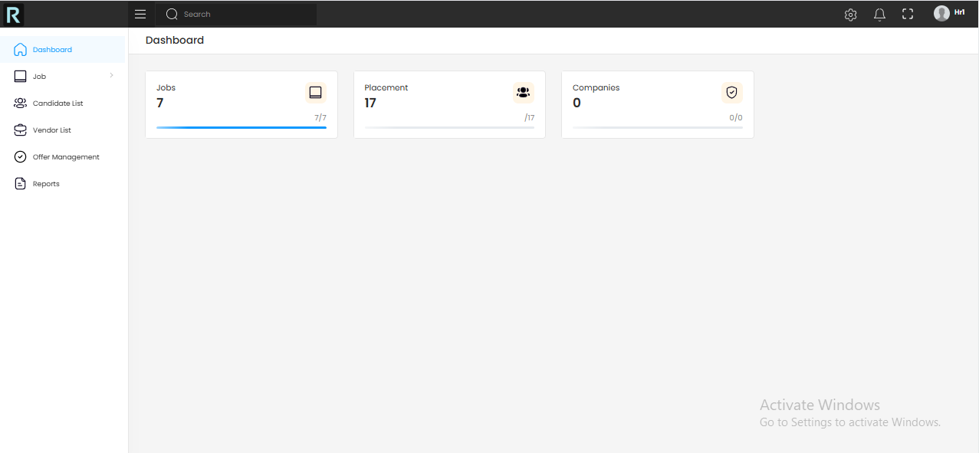
Vendor Dashbord

Slide 6
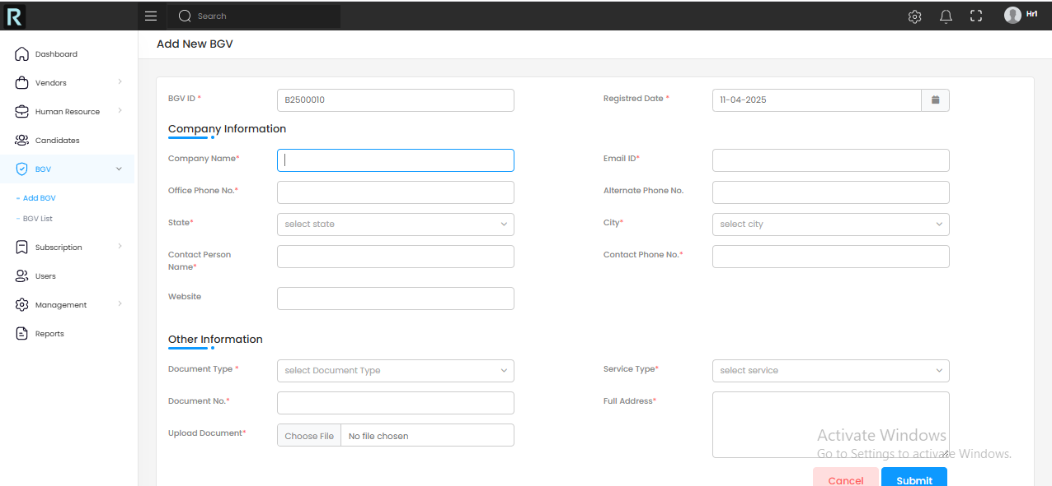
Adding Background Verification

Slide 7
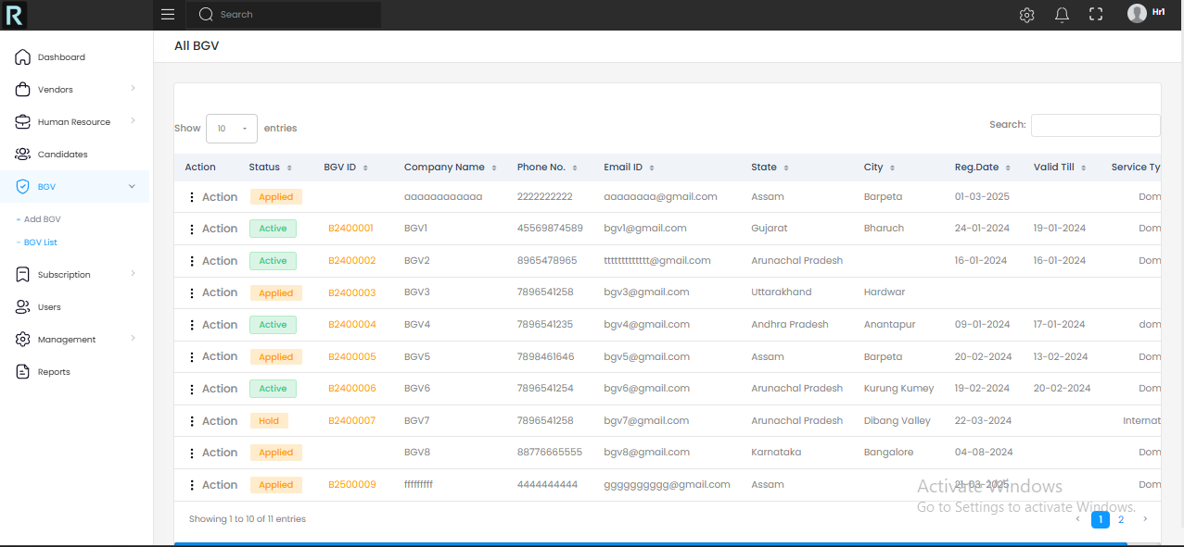
Background Verification List

Slide 8
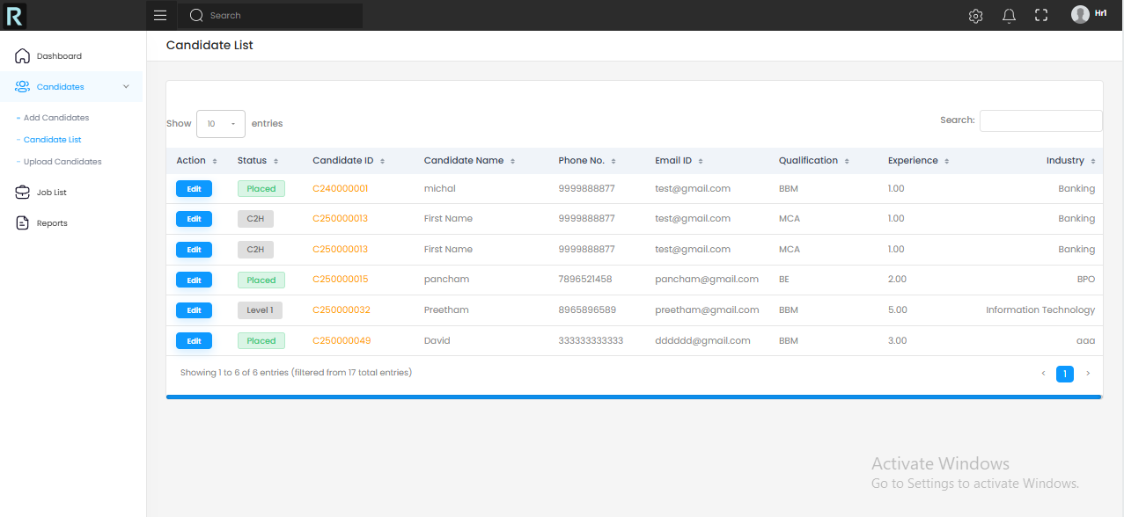
Candidate list

Slide 9
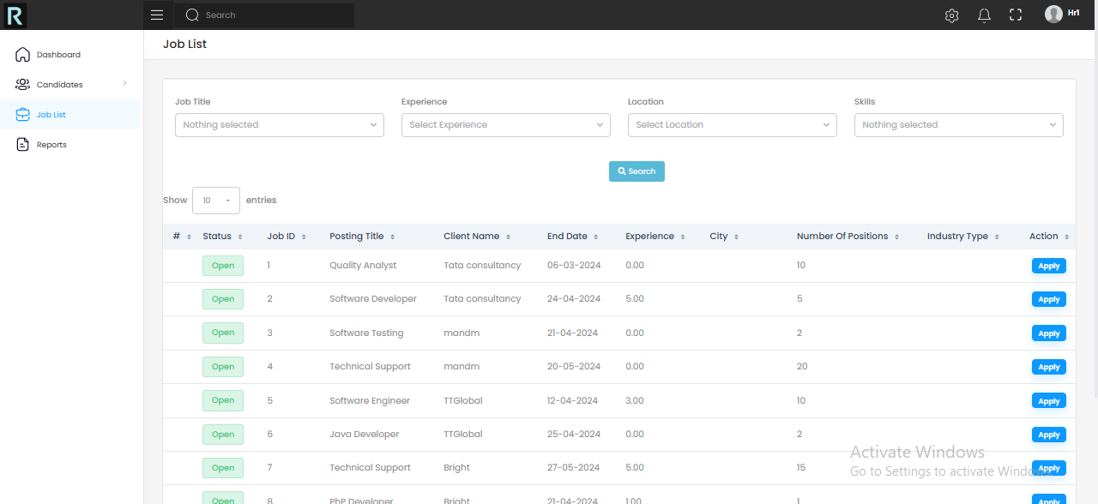
Job List

Slide 10
Github Link
GitHub Repository:
https://github.com/Mojukumar/Rebil

Slide 11


